Slide 1
Partisan Politics, Polarization and Information Processing

Slide 2
WELCOME!
/startSurvey
This study is part of a research project to understand people’s consumption of news. Your participation in this research study is voluntary. You may choose not to participate. If you decide to participate, you may withdraw at any time.
You will need to fill out a questionnaire and perform some tasks. It will take approximately 15 to 20 mins. To avoid excessive waiting time, you will have a maximum of 5 minutes per screen. This is enough time; you will not have to rush. If you take more than 5 minutes on any screen, you will be automatically logged out of the study and you will not be able to continue or restart it. A warning for the same will appear after 4 minutes. If you do not have at least 20 minutes to complete this study, please abandon it by closing your browser.
For agreeing to participate in this study, you will receive a fixed fee of INR ___ on completion. You can additionally earn up to INR ___ based on your performance in the tasks. All payments will be made electronically in the next few days. To process payments, we need your UPI ID.
CONSENT
I am at least 18 years of age . I understand that all the data collected from my responses will only be used for research. My identity will be kept anonymous. My UPI ID or any identifying information will not be linked to my responses in the tasks.

Slide 3
QUESTIONNAIRE (page 1)
/demoracticOpinion
What is your primary source of news? (Social Media, TV, newspaper, online news portals)
Are you affiliated/associated with any political party (Yes, No)
Please report your level of approval for the politics and policies of PM Narendra Modi on the following scale:
(Strongly Disapprove; Disapprove; Neutral; Approve; Strongly Approve)

Slide 4
Page 2 (only proceed if not Neutral in Q3, if Neutral then “thank you for your time. You are currently not eligible for our study. We will contact you in the future when there is a spot available for you.”)
/democraticOpinion2
What is your age (in years)?
What is your gender? (Male, Female, Other, Prefer not to say)
What is your religion? (Hinduism, Islam, Christianity, Sikhism, Jainism, No religion, Other)
In which district was your high school located in?
What best describes your high school? (Private, Central Government, State Government)
What is your highest level of education (Please include any course you are currently pursuing) (high school, undergraduate, graduate, doctorate)
What best describes your undergraduate course? (Science, Social Science, Humanities and Languages, Engineering, Medical, Professional degrees like law/management, Others _______)
Please, choose the answer ‘a little’ below. (A great deal, A lot, A moderate amount, A little, None at all)
Have you voted for Lok Sabha or State Assembly elections in the last 5 years? (yes, no)
What social media apps do you use regularly? (WhatsApp/ Facebook/ Instagram/ Twitter/ YouTube/ Reddit/ Snapchat/ Telegram/ Signal)
How much time do you spend on social media every days (average) (less than 30 minutes, 30-60 minutes, 1-2 hours, 3-5 hours, More than 5 hours

Slide 5
(This will be continued on the previous page itself)
In the recent past, what sources have you used to follow the news? (Choose all that apply)
Social Media:
WhatsApp
Facebook
Instagram
Twitter
YouTube
Reddit
Other______
None
TV News Channels
NDTV
Aaj Tak
Times Now
Republic
Sudarshan News
Zee News
Other______
None
Online News Portals/Blogs
Quint
Newslaundry
Swarajya
OpIndia
ScoopWhoop
Wire
Other______
None
Newspapers
Dainik Jagran
Dainik Bhaskar
Hindustan Times
Amar Ujala
Times of India
The Hindu
Indian Express
Others _________
None

Slide 6
NEWS ACCURACY TASK
/newsAccuracyTask
You will next be shown a social media post. Your task is to judge on a scale of 0% to 100% how likely is it that this post is accurate. Please evaluate the accuracy of the claim made in the post and not whether the statement itself appeared in the press or social media.
Based on the accuracy of your response, you can earn an additional amount of INR Y. Your chance of winning the amount is higher the closer your response is to the true accuracy of the post. For instance, if the post is true, your chance of winning the amount is higher if your response is, say, 70% compared to 40%. The opposite holds if the post is false, i.e., a response of 70% gives you a lower chance of winning the bonus than 40%. Therefore, it is in your best interest to answer as accurately as possible. The buttons below offer some examples and finer details about how the payment procedure works. Reading through these is not necessary and can be skipped.
Payment Procedure (click to expand) Example (click to expand)
/waitingRoomNew

Slide 7
Click to expand Payment Procedure
After you finished reporting your estimates for all posts, for each of the posts you may earn a bonus of XX as follows:
1. The computer will randomly select a number between 0 and 1. Every number between 0 and 1 is equally likely.
2. The difference between your reported estimate and the true accuracy of a post is the so-called prediction error. If your prediction error, multiplied by itself, is not larger than the random number then you will receive the XX bonus. Otherwise, you will receive no bonus.
You may wonder why we have chosen this payment rule. The reason is that this payment rule makes it optimal for you to indicate your true estimates.

Slide 8
Click to expand Example
If the Post is True
Your Estimate | Prediction Error | Chance of Winning Bonus
0% | 1 | 0%
10% | 0.9 | 19%
20% | 0.8 | 36%
30% | 0.7 | 51%
40% | 0.6 | 64%
50% | 0.5 | 75%
60% | 0.4 | 84%
70% | 0.3 | 91%
80% | 0.2 | 96%
90% | 0.1 | 99%
100% | 0 | 100%
If the Post is False
Your Estimate | Prediction Error | Chance of Winning Bonus
0% | 0 | 100%
10% | 0.1 | 99%
20% | 0.2 | 96%
30% | 0.3 | 91%
40% | 0.4 | 84%
50% | 0.5 | 75%
60% | 0.6 | 64%
70% | 0.7 | 51%
80% | 0.8 | 36%
90% | 0.9 | 19%
100% | 1 | 0%

Slide 9
(Only for Control Group)
/newsResponseInfo then send to /newsResponse
Kickout after 5 minutes
This is a real-time study, and participants are responding sequentially. When assessing the accuracy of the post, you will be able to see the responses of other participants, if any, who have already submitted their responses. Likewise, participants assessing the post after you will be able to see the responses of all before them, including yours.
Please be assured that everyone’s responses will remain completely anonymous. No one will be able to connect your responses to you personally.

Slide 10
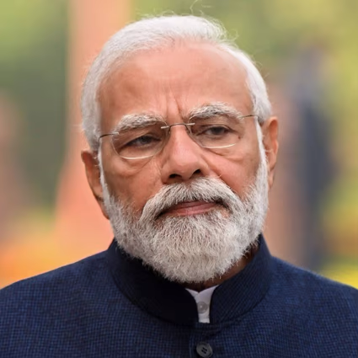
(Only for T1 and T2)
Kickout after 5 minutes
/newsResponseInfo then send to /newsResponse
This is a real-time study, and participants are responding sequentially. When assessing the accuracy of the post, you will be able to see the responses of other participants, if any, who have already submitted their responses. Likewise, participants assessing the post after you will be able to see the responses of all before them, including yours.
Additionally, to signal participants’ political opinions and affiliation, everyone’s approval rating of Narendra Modi that they reported in the questionnaire will be displayed. How much they approve or disapprove of PM Modi is shown by thumbs up and thumbs down icons, as explained in the table below
Icon | Affiliation
[PM Photo] 👍👍 | Strongly Approve 100
[PM Photo] 👍 | Approve 75
[PM Photo] 👎 | Disapprove 25
[PM Photo] 👎👎 | Strongly Disapprove 0
Use this image in the legend and table
Please be assured that everyone’s responses will remain completely anonymous. No one will be able to connect your responses to you personally.

Slide 11
(CONTROL)
Kickout after 5 minutes
/newsResponseInfo then send to /newsResponse
This is a real-time study, and participants are responding sequentially. When assessing the accuracy of the post, you will be able to see the responses of other participants, if any, who have already submitted their responses. Likewise, participants assessing the post after you will be able to see the responses of all before them, including yours.
Please be assured that everyone’s responses will remain completely anonymous. No one will be able to connect your responses to you personally.

Slide 12
(Only for Adhocs)
In the next screen, you will be shown the social media post. Please be assured that your response will remain completely anonymous. No one will be able to connect your responses to you personally.

Slide 13
/newsResponse [Treatment]
Please read the following social media post and indicate your belief about its accuracy on the slider below, where 0% means that the post is definitely false and 100% means that it is definitely true. Please evaluate the accuracy of the claim made in the post and not whether the statement itself appeared in the press or social media. The post is to be considered as accurate only is all claims made in it is true.
[If the participant is the first respondent: “You are the first respondent. So there is no information to share about others’ responses. However, your response and affiliation will be shared with others who respond after you.”]
[If not the first respondent: Before you answer, we will show you the responses and affiliations of others before you in the order they responded. Likewise, your response and affiliation will be shared with others who respond after you.]
[INSERT NEWS ITEM]
[INSERT INFORMATION OF EARLIER RESPONDERS]
Please report your belief:
[INSERT SLIDER]

Slide 14
/newsResponse [CONTROL]
Please read the following social media post and indicate your belief about its accuracy on the slider below, where 0% means that the post is definitely false and 100% means that it is definitely true. Please evaluate the accuracy of the claim made in the post and not whether the statement itself appeared in the press or social media. The post is to be considered as accurate only is all claims made in it is true.
[If the participant is the first respondent: “You are the first respondent. So there is no information to share about others’ responses. However, your response will be shared with others who respond after you.”]
[If not the first respondent: Before you answer, we will show you the responses of others before you in the order they responded. Likewise, your response will be shared with others who respond after you.]
[INSERT NEWS ITEM]
[INSERT INFORMATION OF EARLIER RESPONDERS (only accuracy and not affiliation)
After x seconds: You have 45 seconds to . . . .]
Please report your belief:
[INSERT SLIDER]

Slide 15
/newsResponse (AD HOC)
Please read the following social media post and indicate your belief about its accuracy on the slider below, where 0% means that the post is definitely false and 100% means that it is definitely true. Please evaluate the accuracy of the claim made in the post and not whether the statement itself appeared in the press or social media. The post is to be considered as accurate only is all claims made in it is true.
[INSERT NEWS ITEM]
After x seconds: You have 45 seconds . . . .
Please report your belief:

Slide 16
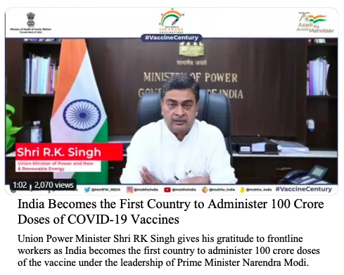
The following will appear as indicated in the previous slide. On mobile view, first the post, then the responses
Participant No. | Affiliation | Belief About the Accuracy
1 | [PM Photo] 👍👍 | 83%
2 | [PM Photo] 👍 | 65%
3 | [PM Photo] 👎 | 45%
4 | [PM Photo] 👎👎 | 12%
5 | You

Slide 17
Finally, we ask you to respond to the following 3 questions. Every correct answer will earn you INR _____
If you’re running a race and you pass the person in second place, what place are you in?
A farmer had 15 sheep and all but 8 died. How many are left?
If it takes 2 nurses 2 minutes to check 2 patients, how many minutes does it take 40 nurses to check 40 patients?

Slide 18
Earnings
For your participation in today’s study, you win a reward of INR X
For your response in the accuracy task, you win an additional reward of INR Y
For your answers in the three additional questions, you win a reward of INR Z
Your total earning from this study is INR (X+Y+Z), which will be sent to your UPI ID <enter their UPI id from db> in a few days.
Thank you for your time! Please press the End Survey button below to acknowledge the above information and exit.

